Slide 1
GFIPM Deliverables Overview
GFIPM Delivery Team Meeting
November 2011

Slide 2
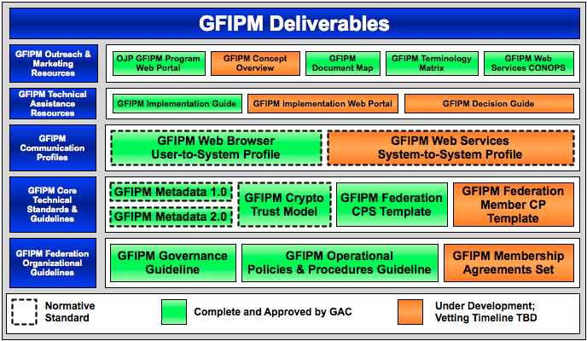
GFIPM Deliverables Landscape Circa November 2010

Slide 3
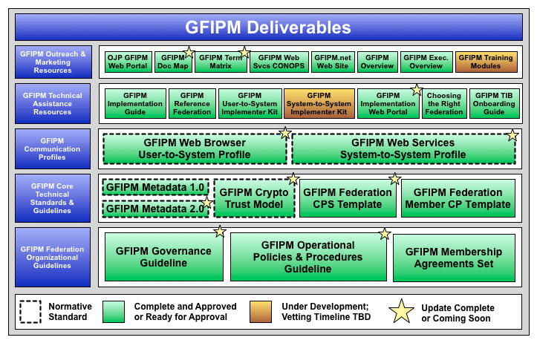
GFIPM Deliverables Landscape Circa November 2011

Slide 4
What has changed? (1/2)
Deliverables Completed in 2011
GFIPM Membership Agreements Set ¹
GFIPM Federation Member CP Template ¹
GFIPM Web Services System-to-System Profile ¹
GFIPM Overview
Choosing the Right Federation
GFIPM TIB Onboarding Guide ^{1,2}
GFIPM Implementation Web Portal
¹ Complete but not yet approved by Global
² Did not appear on diagram last year

Slide 5
What has changed? (2/2)
Documents Revised in 2011
GFIPM Governance Guideline
GFIPM Operational Policies & Procedures Guideline
GFIPM Metadata 2.0
GFIPM Crypto Trust Model
GFIPM Web Browser User-to-System Profile
GFIPM Terminology Matrix

Slide 6
Organizational Guidelines
Governance Guideline
Operational Policies and Procedures Guideline
Membership Agreements Set
You Are Here →

Slide 7
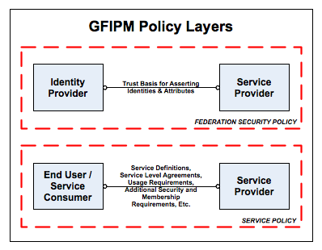
GFIPM Policy in Context
You Are Here →
Notes:
Policies and agreements for access to sensitive resources can be separated into two layers.
Identity and Trust Policy: “How do we ensure that the agency operating a sensitive resource can trust the identity and attribute data it receives about users?”
Service-Level Policy: Includes service-level agreements (SLAs), resource-specific usage agreements, fee negotiation, etc.
GFIPM policy addresses only the first question.
Our goal is to abstract away the issue of identity and trust, so that service-level policies do not need to address it.

Slide 8
Governance Guideline
Defines federation governance structure and roles
Board of Directors
Federation Mgmt. Org. (FMO)
Identity Provider Org. (IDPO)
Service Provider Org. (SPO)
Trusted Identity Broker Org. (TIBO)
Defines decisions to be made by each party
Version 1.0 approved by GAC in 2010
Version 1.1 completed in 2011
Includes proper use of “IDP” versus “IDPO”, etc.
Properly covers the TIBO use case
Includes misc. edits driven by NIEF Bylaws
Ready for review now
Notes:
The GFIPM Governance Guideline has been updated since version 1.0 based on our experiences in adapting it for use in NIEF.

Slide 9
Operational Policies and Procedures Guideline
Describes policies and procedures that govern basic operation of a federation
Membership Lifecycle
Change Mgmt. for Normative Standards
Help Desk and Issue Resolution Policies
Version 1.0 approved by GAC in 2010
Version 1.1 completed in 2011
Includes proper use of “IDP” versus “IDPO”, etc.
Properly covers the TIBO use case
Includes misc. edits driven by NIEF Bylaws
Ready for review now
Notes:
The GFIPM OP&P Guideline has been updated since version 1.0 based on our experiences in adapting it for use in NIEF.

Slide 10
Membership Agreements Set
Set of templates to be completed by each federation member
Revised in 2011
Includes TIBO membership agreement templates
Includes proper use of “IDP” versus “IDPO”, etc.
Complete and ready for review now
IDPO Documents
Request-to-Join Form
Signed IDPO Agreement
Local User Agreement
Local User Vetting Policy
IDPO Attribute Map
Implementation Doc Form
Common Documents
Application Form
Authority to Operate Doc(s)
Local Security Policy
FIPS 200 Checklist
TIBO Documents
Request-to-Join Form
Signed TIBO Agreement
Brokered IDPO Registry Form
Brokered IDPO Local Security Policies
Brokered IDPO Local User Agreements
Brokered IDPO Local User Vetting Policies
Brokered Attribute Map
Brokered IDPO FIPS 200 Checklists
Implementation Doc Form
SPO Documents
Request-to-Join Form
Signed SPO Agreement
Local Privacy Policy
Access Control Policy Map
Implementation Doc Form
Notes:
The membership agreement templates have been updated since version 1.0 based on our experiences in adapting them for use in NIEF.

Slide 11
Core Technical Standards/Guidelines
GFIPM Metadata Spec
Cryptographic Trust Model
Member Certificate Policy Template
Certification Practice Statement Template
You Are Here →

Slide 12
GFIPM Metadata Spec
Provides common attribute language for identity mgmt., access control, auditing, etc.
Version 1.0 approved by GAC in 2008
Specifies a structured XML attribute model
Includes “user” and “entity” attributes
Version 2.0 approved by GAC in 2010
Specifies a “flat” attribute model (no XML)
More compatible with existing COTS products
New attribute categories: “resource”, “action”, “environment”
Version 2.0 revised in 2011
Clarifies ID formats to better support inter-federation (TIBs)
Includes a new “GFIPM Federation Name Registry”
Ready for review now (?)
Will include obligations in near future (early-mid 2012)

Slide 13
Cryptographic Trust Model
Defines normative schema for GFIPM Cryptographic Trust Fabric
Document containing certs and service endpoint metadata for every system in the federation
Based on SAML 2.0 Metadata Spec
Also defines rules for trust fabric creation, distribution, updates, etc.
Version 1.1 approved by GAC in 2010
Supports User-to-System Profile
Version 1.2 completed in 2011
Also supports System-to-System Profile (Web Services)
Ready for review now
Notes:
The GFIPM Crypto Trust Model has been revised based on our experience with GFIPM web services.

Slide 14
Member Certificate Policy Template
Provides a CP template for a federation
Federation can adapt it as needed
Purpose is to specify CP for private keys on which federation trust fabric relies
Based on IETF RFC 3647 (X.509 PKI CP/CPS)
Draft submitted to DT in late 2010
Direction and scope unclear at that time
Underwent major revisions in 2011
Revised in conjunction with NIEF CP
Ready for review now
Notes:
The GFIPM CP Template has been revised significantly since its last draft version.
The changes were driven by similar changes to the NIEF CP.
We have used the RFC 3647 CP template, which is applicable to a classical PKI model, but adapted each section of the template to the GFIPM trust model.

Slide 15
Certification Practice Stmt. Template
Provides a CPS template for any federation CA
Federation CA can adapt it as needed
Purpose is to describe CA’s security measures
Based on IETF RFC 3647 (X.509 PKI CP/CPS)
Version 1.0 approved by GAC in 2010
Requires major revisions
Current version is based on an outdated CP concept
Not useful – may cause confusion
Should we redact from GFIPM and Global web sites?
New version must jibe with Member CP Template
Notes:
The GFIPM CPS Template is currently out of date, and needs to be addressed.
It is unclear what, if anything, we should do with it.

Slide 16
Communication Profiles
Web Browser User-to-System Profile
Web Services System-to-System Profile
You Are Here →

Slide 17
Web Browser User-to-System Profile
Normative spec for browser-facing services
Identity Providers and Service Providers
Includes rules for IDP “discovery”
Uses SAML Single Sign-On and Single Log-Out
But SLO is not well-supported in SAML products
Relies on GFIPM Crypto Trust Model
Version 1.1 approved by GAC in 2010
Version 1.2 completed in 2011
Contains misc. updates based on operational experience
Ready for review now (?)
Will include revisions for FICAM conformance in early-mid 2012
Notes:
Should we push version 1.2 through the approval process now, or wait until after we align the doc with FICAM?

Slide 18
Web Services System-to-System Profile
Normative spec for SOAP-based web services
WS Provider, WS Consumer, Token Services, Etc.
Covers eight (8) “service interaction models” (SIPs)
Important use cases Identified by GFIPM stakeholders
Conforms to GRA Reliable Secure Web Services SIP
Relies on GFIPM Crypto Trust Model
Uses standard GFIPM Crypto Trust Fabric
Version 1.0 completed in 2011
Includes normative language for four (4) SIPs
Sample implementations have been developed
Ready for review now
Version 2.0 to be developed in 2012
Will include normative language for remaining SIPs
Will require additional sample implementation work

Slide 19
Technical Assistance Resources
You Are Here →
Implementation Guide
Reference Federation
User-to-System Implementer Kit
System-to-System Implementer Kit
Implementation Web Portal
Choosing the Right Federation
TIB Onboarding Guide

Slide 20
Implementation Guide
Contains detailed implementer instructions
From requirements analysis to system deployment
Version 1.0 approved by GAC in 2010
Covers User-to-System use case only
Microsoft Word / PDF Format
Converted to HTML wiki articles in 2011
Posted on GFIPM Implementation Web Portal
Future implementer guidance will be wiki-based

Slide 21
GFIPM Reference Federation
Test-bed for conformance and interop. testing
Contains GTRI-managed reference IDPs and SPs
Online since ~2007
Available for use by entire GFIPM community
Plan for 2012: Stand up reference web svcs.
WSPs, WSCs, etc.

Slide 22
User-to-System Implementer Kit
Downloadable virtual machines (VMs)
Sample IDP and SP implementations
Configured for use in GFIPM Reference Federation
Downloadable packages and source code
Available since ~2008
Updated periodically as needed
Kept current with security patches, etc.
Based on Shibboleth project
One of several implementer options
Implementers can also use COTS products

Slide 23
System-to-System Implementer Kit
Under development now by GTRI
Target release date: Spring 2012
Only implementer option for now
No products can support GFIPM WS out of the box
Will offer sample WSPs, WSCs, etc.
Will support Java Metro and .NET 3.5
Will define implementer APIs
Will be available for download as zip files
Java/Metro version may also be available as a VM

Slide 24
Implementation Web Portal
Contains:
Articles from GFIPM Implementation Guide
Currently User-to-System only
Links to downloadable developer toolkits
Implementer mailing list with archive
List email address: implementers@gfipm.net
Sign up at http://mail.gfipm.net/
Developed and deployed in 2011
Online now at http://impl.gfipm.net/
Will contain System-to-System articles soon

Slide 25
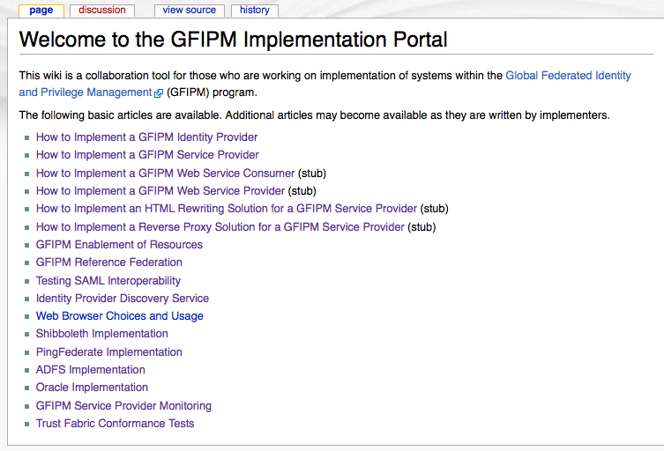
Implementation Portal Screen Shot
Notes:
This screen shot is from http://impl.gfipm.net/.

Slide 26
Choosing the Right Federation
Provides high-level mgmt. at prospective member organizations with a framework for deciding whether to join a GFIPM Federation
Approved by DT in early 2011
Published in HTML format at GFIPM.net
http://gfipm.net/choosing-the-right-federation.html
Under final review by BJA

Slide 27
Trusted Identity Broker (TIB) Onboarding Guide
Clearly defines the terms TIB and TIBO
Defines requirements for membership as TIBO
All reqs have been captured in latest Governance and Policies/Procedures docs
Written in early 2011
Driven by FBI CJIS possibly joining NIEF as a TIBO
Approved by GFIPM DT
Ready for further Global review

Slide 28
Outreach and Marketing Resources
You Are Here →
GFIPM Web Sites
Document Map
Terminology Matrix
Web Services CONOPS
Overview
Executive Overview
Training Modules

Slide 29
GFIPM Web Sites
http://it.ojp.gov/gfipm
GAC-approved GFIPM docs are available here
OJP site includes info about all OJP programs
http://gfipm.net/
Provides a more “GFIPM-centric” view
Site overhauled in 2010; Minor updates in 2011

Slide 30
GFIPM Document Map
Provides an overview of the GFIPM documentation landscape
Covers normative and non-normative docs
Includes all documents noted in this slide deck
Version 1.0 approved by GAC in 2010
Due for a refresh based on progress in 2011
Does this doc provide any value going forward?
GFIPM.net provides the same basic info online
Would a refresh be worth the effort?

Slide 31
GFIPM Terminology Matrix
Defines basic GFIPM terms
Maps GFIPM terms to WS/SOA terms
Reconciles GFIPM terms with analogous terms in other paradigms/standards (GRA, SAML)
Version 1.0 approved by GAC in 2010
Revised in 2011 based on GFIPM-WS progress
Added new terms and deleted others

Slide 32
GFIPM Web Services CONOPS
Defines web services “interaction models”
Based on use cases identified by stakeholders
Also identifies functional requirements
Message integrity, confidentiality, etc.
Precursor to GFIPM System-to-System Profile
Version 1.0 approved by GAC in 2010
Notes:
Should we keep the CONOPS doc up to date as we move forward and refine the GFIPM web services concept?

Slide 33
GFIPM Overview
Provide high-level mgmt at prospective member organizations with a broad overview of GFIPM
Overview, program history, GFIPM benefits, etc.
Approved by DT in early 2011
Published in HTML format at GFIPM.net
http://gfipm.net/gfipm-overview.html
Under final review by BJA
Notes:
Suzette McLeod (BJA) wants to propose several changes to this doc, to accommodate various audience perspectives.
Enterprise perspective
End-user perspective
Service provider perspective
Identity provider perspective
We need further clarification from her before we can publish this.
Note that the current version of this doc is already published in HTML form at GFIPM.net.

Slide 34
GFIPM Executive Overview
Two-page glossy flier
Briefly describes GFIPM program and goals
Developed in ~2009

Slide 35
GFIPM Training Modules
Compiled a list of module topics in 2010
No further progress in 2011
Training Module Topics
GFIPM Overview
Federation Establishment
IDP Implementation
SAML SP Implementation
Web Svcs. Implementation
Enterprise Attribute-Based Access Control
Inter-Federation Information Exchange
GFIPM in Relation to Other Info-Sharing Programs

Slide 36
GFIPM Deliverables Landscape Circa November 2011 (Summary)

